Slide 1
ASCON Benchmark
Presented by: Sebastian Bendezu, Gil Gandionco, Isabel Warth, Jessica Ramirez

Slide 2
Motivation for ASCON Implementation
-ASCON is a lightweight cryptographic algorithm designed for secure and efficient encryption and decryption in resource-constrained environments like IoT and embedded systems.
- With the rise of small-scale devices, emulating and understanding ASCON performance under various conditions is important for any sort of practical deployment or applications
Our Goal
Measure Encryption/Decryption Times and Throughput for ASCON Across:
-Different file sizes (up to 1GB)
-Multi-threading (1-4 threads)
-Different processors (Intel Core i7, i5, ARM Cortex-a72, AMD Ryzen 5 3600)

Slide 3
State of the Art in Lightweight Cryptography
Used in Automotive Systems: Modern vehicles rely on real-time communication for V2X (vehicle-to-everything) systems, autonomous driving, and safety features.
ASCON’s Role: Secures V2X messages between vehicles and infrastructure (e.g., traffic lights) to prevent tampering. Encrypts data within onboard systems, like collision sensors and braking modules, ensuring real-time response without breaches.
ASCON’s low latency ensures critical operations, such as emergency braking, occur without delays.
Compared to The Advanced Encryption Standard (AES):
Algorithm | Speed (Small Files) | Security | Energy Efficiency
ASCON | High | Strong | High
AES | Moderate | Strong | Moderate
ASCON is comparitively a lightweight algorithm that's more efficient on low-end devices, Ascon is comparable to AES in terms of security level but with a smaller memory footprint.

Slide 4
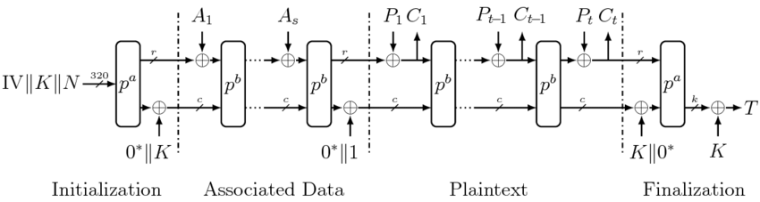
Notes:
Key components of ASCON
Key
Nonce
Associated data (AD) - optional data that is authenticated but not encrypted
Plaintext
Ciphertext
Authentication tag (T) - attached to the ciphertext to ensure authenticity and integrity
Rounds
Encryption
Initialize state S = [IV, K, N]
320-bit internal state (S)
Key
Nonce
Fixed initialization vector (IV)
S is represented as five 64-bit words
Key is split into 64-bit chunks
Nonce is split into 64-bit chunks
Absorb associated data into S - optional data that is authenticated but not encrypted
Each 64-bit block of AD is XORed into the state, followed by a permutation
Needs to include a padding bit if AD is not a multiple of the block size
Plaintext
XORed with the state to produce ciphertext
Extract Ciphertext block
State undergoes a permutation for mixing
Plaintext needs to be padded if plaintext is not a multiple of the block size, Concatenate the key with 0s
Finalize state using K
Key is XORed into the state twice to finalize encryption
Extract tag T from S
128-bit authentication tag is generated from the state and attached to the cipher text
Output ciphertext + tag
12 rounds Pa in initilization, 6 rounds Pb
Sbox is used in every round of permutation
predefined substitution table with 32 possible input (5bits) values corresponding to 32 corresponding output values (5bits), similar to a look up table where you match the input to corresponding output values
Layered diffusion layer, series of rotation and xors
the state is divided into r(rate) and c(capacity). rate is 64 bits and capacity is 256 bits. Rate (r): The portion used to XOR input (e.g., plaintext or associated data) and output ciphertext. Capacity (c): The rest of the state, which provides security by ensuring resistance to cryptanalytic attacks.
Decryption
Initialization
Associated Data Absorption
Ciphertext processing
XOR with the state to recover plaintext
Update S with ciphertext
Permute S
Ciphertext needs to be padded if cipher text is not a multiple of the block size
Verify tag T
Tag is recomputed using the current and state and if it does not match the tag provided in ciphertext, the decryption failed
If tag is valid, output plaintext
Else, reject as invalid
0 and 1 are for padding if the AD, plaintext, or ciphertext
Authenticity: Ensures the associated data has not been tampered with.
Integrity: Verifies that the associated data remains unaltered during transmission or storage.

Slide 5
System Overview
ASCON was implemented on
Raspberry Pi 4 (ARM)
Laptops and a PC (x86)
Processors:
Raspberry Pi 4 - ARM Cortex-A72 @ 1.80 GHz
Laptop 1 - Intel Core i7-8565U @ 1.80 GHz
Laptop 2 - Intel Core i5-1135G7 @2.40 GHz
PC - AMD Ryzen 5 3600 @ 4.18 GHz
Implementation was through C
For performance optimization of both platforms

Slide 6
System Overview
For encryption/decryption speed and throughput:
Tested up to 4 threads
ARM Cortex allows 1 thread per core (total cores = 4)
Whereas
Intel Core i7: (2 threads)*(total cores = 4)
Intel Core i5: (2 threads)*(total cores = 4)
AMD Ryzen 5: (2 threads)*(total cores = 6)

Slide 7
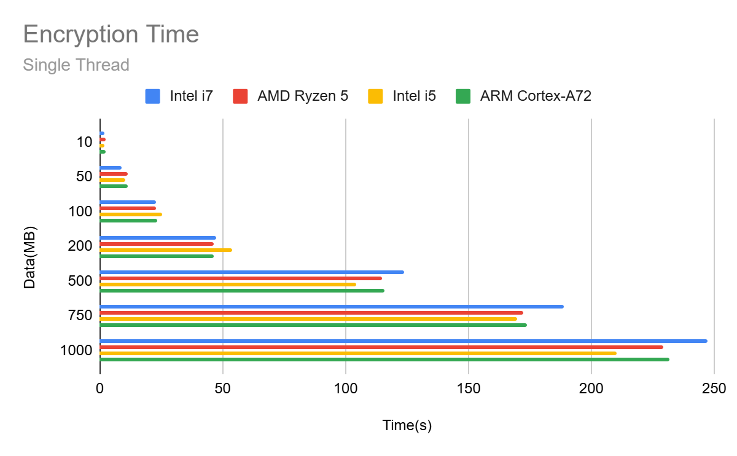
Encryption Times (Single Thread)

Slide 8
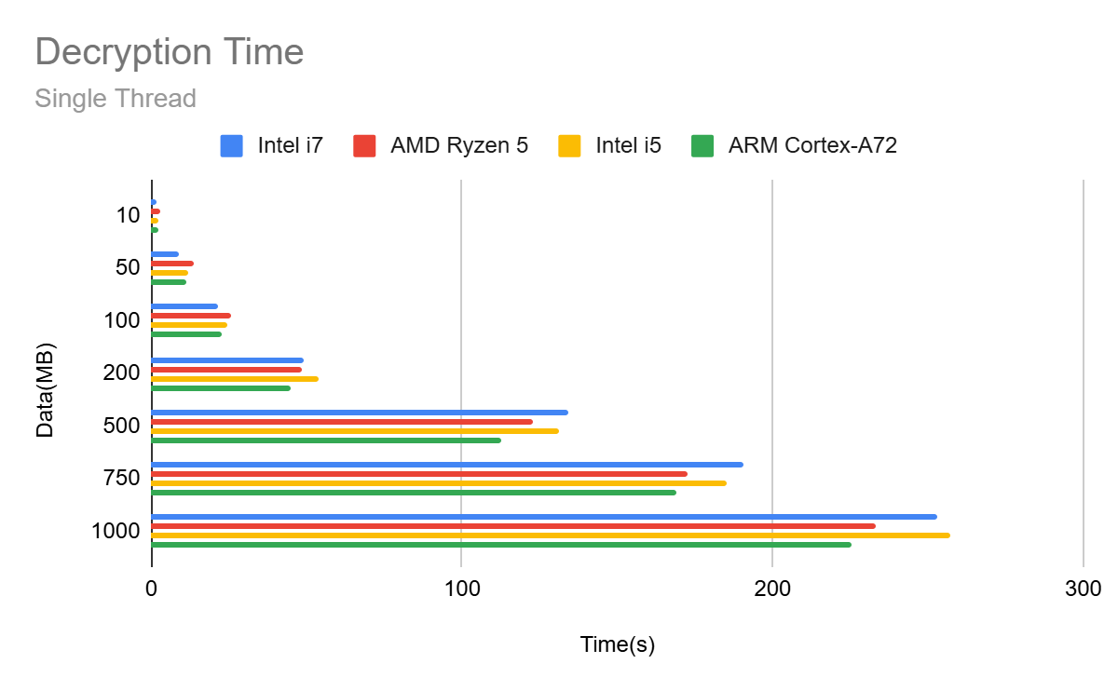
Decryption Times (Single Thread)

Slide 9
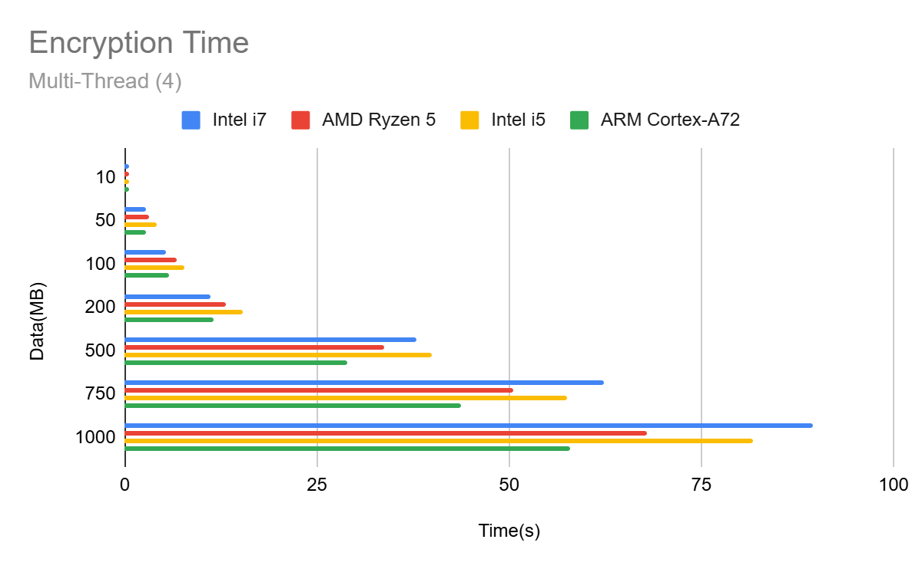
Encryption Times (Multi-Thread)

Slide 10
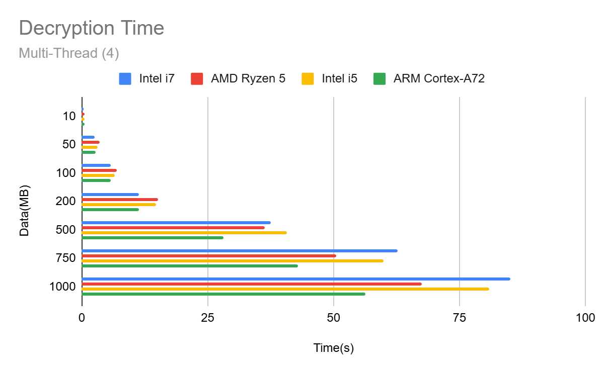
Decryption Times (Multi-Thread)

Slide 11
CPU | 1 Thread | 2 Threads | 3 Threads | 4 Threads
Intel Core i7-8656u 1.8 GHz up to 4.6 GHz | 4.55 MB/s | 9.05 MB/s | 13.52 MB/s | 16.07 MB/s
Ryzen 5 3600 4.18 GHz | 4.34 MB/s | 7.87 MB/s | 11.58 MB/s | 15.46 MB/s
Intel Core i5-1135G7 up to 4.2 GHz | 4.47 MB/s | 7.99 MB/s | 11.20 MB/s | 13.12 MB/s
ARM Cortex-A72 1.8GHz | 4.31 MB/s | 8.64 MB/s | 13.29 MB/s | 17.96 MB/s
Average throughput for each CPU per thread count (Encryption)

Slide 12
CPU | 1 Thread | 2 Threads | 3 Threads | 4 Threads
Intel Core i7-8656u 1.8 GHz up to 4.6 GHz | 4.48 MB/s | 8.93 MB/s | 13.58 MB/s | 16.22 MB/s
Ryzen 5 3600 4.18 GHz | 4.02 MB/s | 7.56 MB/s | 10.94 MB/s | 14.69 MB/s
Intel Core i5-1135G7 up to 4.2 GHz | 4.09 MB/s | 7.06 MB/s | 10.33 MB/s | 14.50 MB/s
ARM Cortex-A72 1.8GHz | 4.44 MB/s | 8.87 MB/s | 13.65 MB/s | 18.38 MB/s
Average throughput for each CPU per thread count (Decryption)

Slide 13
Conclusion
Benchmarking ASCON encryption and decryption with a focus on speed and data throughput
Maximize the potential between all CPU processors, utilizing multiple threads to observe the benefits of the multiple cores each CPU provides.
Discover the upper limits of each CPU’s data throughput with regards to ASCON cryptographic algorithm.

Slide 14
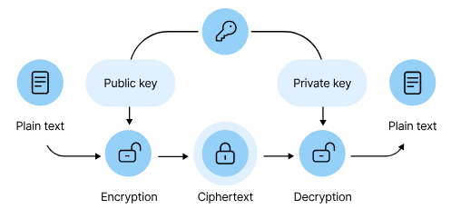

Future Work
Look into asymmetric cryptography, such as RSA which includes key generation and increases it complexity.
Extend benchmark across other devices for example GPU’s.
Post-Quantum Cryptography, which represents the future of secure cryptography.
Kyber or Dilithium

